Slide 1
Regression in R Messy count data
Rosemary Hartman
California Department of Water Resources
IEP Workshop
DATE

Slide 2
Chi-squared
Yes
ANOVA
Yes
Response parametric?
Categorical response
Predictor(s) categorical?
Classification tree
Kruskal-Wallis
Yes
Numerical response
& categorical predictor
No
No
>2 response categories?
Logistic regression
Yes
No
Response parametric?
T-test
Yes
Yes
Response categorical?
>2 predictor categories?
No
No
Wilcoxon rank-sum
Yes
No
Predictor(s) categorical?
Response: Zero-inflated?
Yes
Zero-Inflated negative binomial or zero-inflated Poisson regression
No
No
Negative binomial or Poisson regression
Response:
catch data
(discrete integers)?
Yes
Key
Numerical response & numerical predictor
Response binary (y=0|1) or proportional (0 ⩽y⩽ 1)?
Yes
Logistic regression
Response
No
Predictor
No
Response: continuous?
Yes
Linear regression
Analysis
Yes
Linear, linearizable (e.g., log or power-law), or sigmoidal relationship between response and main predictor ?
Generalized additive model
No

Slide 3
Chi-squared
Yes
ANOVA
Yes
Response parametric?
Categorical response
Predictor(s) categorical?
Classification tree
Kruskal-Wallis
Yes
Numerical response
& categorical predictor
No
No
>2 response categories?
Logistic regression
Yes
No
Response parametric?
T-test
Yes
Yes
Response categorical?
>2 predictor categories?
No
No
Wilcoxon rank-sum
Yes
No
Predictor(s) categorical?
Response: Zero-inflated?
Yes
Zero-Inflated negative binomial or zero-inflated Poisson regression
No
No
Negative binomial or Poisson regression
Response:
catch data
(discrete integers)?
Yes
Key
Numerical response & numerical predictor
Response binary (y=0|1) or proportional (0 ⩽y⩽ 1)?
Yes
Logistic regression
Response
No
Predictor
No
Response: continuous?
Yes
Linear regression
Analysis
Yes
Linear, linearizable (e.g., log or power-law), or sigmoidal relationship between response and main predictor ?
Generalized additive model
No

Slide 4

Assumptions of a linear model
The true relationship is linear
Each group sample is drawn from a normally distributed population
Errors are normally distributed
Homoscedasticity of errors (or, equal variance around the line).
Independence of the observations

Slide 5
Assumptions of Delta Smelt
No one can catch me
I like schooling
Wakasagi are actually Delta Smelt in disguise
Normality is for loosers

Slide 6
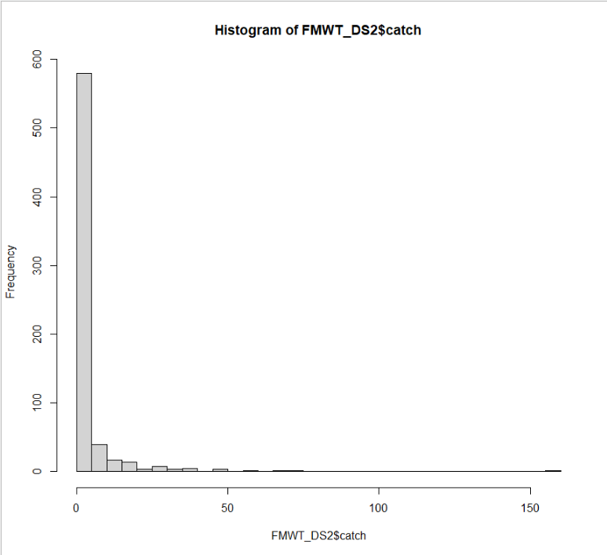
So how do I run a linear model on smelt data?
Normal distribution
Smelt catch distribution

Slide 7
So how do I run a linear model on smelt data?
Normal distribution
Log-transformed Smelt catch distribution
TOO MANY ZEROS

Slide 8
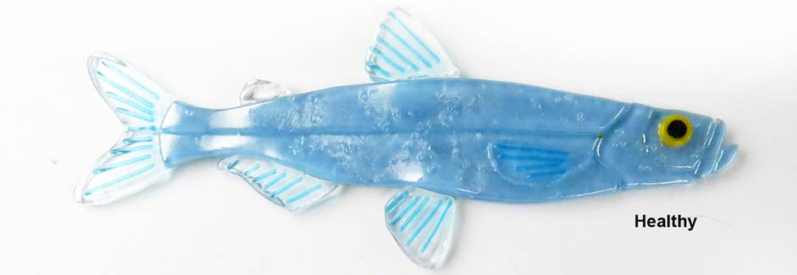
So what do we do about zeros? Types of zeros:
Structural zeros.
Notes:
1. Delta smelt are not caught because the habitat is not suitable (too hot, to clear, too salty).
2 Delta smelt are not caught because the midwater trawl doesn't sample the top part of the water well and smelt hang out near the surface.
3. Delta smelt were caught, but Rosie thought they were Wakasagi.
4. The habitat was suitable but the smelt weren't using it.

Slide 9
So what do we do about zeros? Types of zeros:
I’m escaping!
Structural zeros.
Design/sampling error.
Notes:
1. Delta smelt are not caught because the habitat is not suitable (too hot, to clear, too salty).
2 Delta smelt are not caught because the midwater trawl doesn't sample the top part of the water well and smelt hang out near the surface.
3. Delta smelt were caught, but Rosie thought they were Wakasagi.
4. The habitat was suitable but the smelt weren't using it.

Slide 10
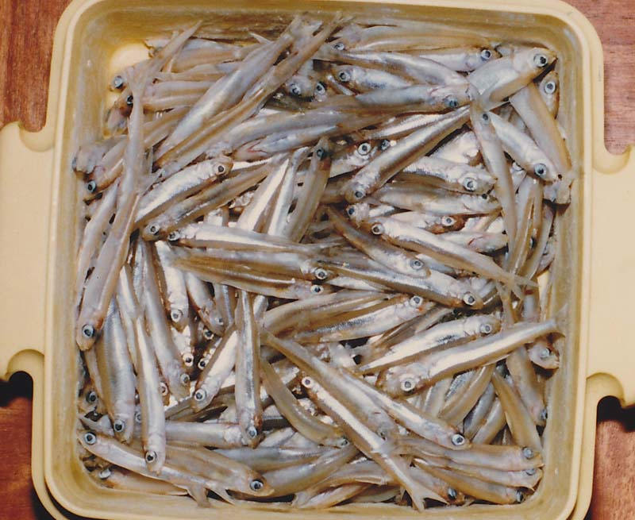
So what do we do about zeros? Types of zeros:
Structural zeros.
Design/sampling error.
3. Observer error
OK, which is smelt and which is wakasagi?
Notes:
1. Delta smelt are not caught because the habitat is not suitable (too hot, to clear, too salty).
2 Delta smelt are not caught because the midwater trawl doesn't sample the top part of the water well and smelt hang out near the surface.
3. Delta smelt were caught, but Rosie thought they were Wakasagi.
4. The habitat was suitable but the smelt weren't using it.

Slide 11
So what do we do about zeros? Types of zeros:
Structural zeros.
Design/sampling error.
3. Observer error
4. Smelt error
Notes:
1. Delta smelt are not caught because the habitat is not suitable (too hot, to clear, too salty).
2 Delta smelt are not caught because the midwater trawl doesn't sample the top part of the water well and smelt hang out near the surface.
3. Delta smelt were caught, but Rosie thought they were Wakasagi.
4. The habitat was suitable but the smelt weren't using it.
There are different types of models to deal with different types of zeros. Normal models are pretty good at figuring out 3 and 4, and some of 2, but not as good at 1.

Slide 12
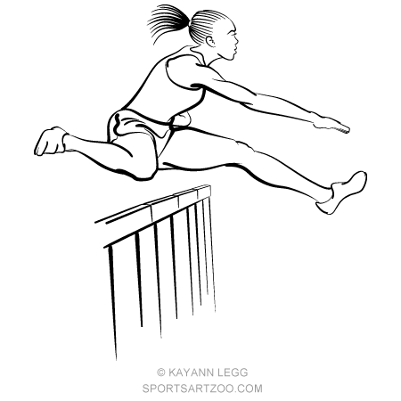
Hurdle (two-part) model
I am not here because the habitat is bad.
You thought I was a wakasagi
The habitat is good, but I’m not here
You trawled right under me and didn’t catch me
0 smelt
>0 smelt
Here I am!
Notes:
Sketch of a two-part, or hurdle model. There are two processes; one is causing zeros
versus non-zeros, the other process is explaining the non-zero counts. This is expressed with the
hurdle in the circle; you have to cross it to get non-zero counts. The model does not make a
distinction between the different types of zeros.
This is easy to set up, but doesn’t give you as much info.

Slide 13
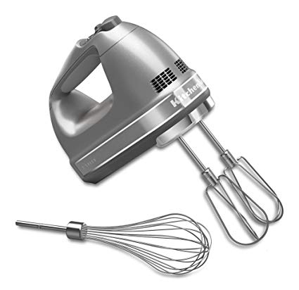
Zero-inflated (mixture) model
You thought I was a wakasagi
The habitat is good, but I’m not here
You trawled right under me and didn’t catch me
0 smelt
I am not here because the habitat is bad.
0 smelt
>0 smelt
Here I am!
Notes:
Sketch of the underlying principle of mixture models (ZIP and ZINB). In counting
hippos at sites, one can measure a zero because the habitat is not good (the hippos don’t like
the covariates), or due to poor experimental design and inexperienced observers (or experienced
observers but difficult to observe species)

